Slide 1
Unit 8.1
Pointer

Slide 2
Address in C
Before you get into the concept of pointers, let's first get familiar with address in C.
If you have a variable var in your program, &var will give you its address in the memory, where & is commonly called the reference operator.
You must have seen this notation while using scanf() function. It was used in the function to store the user inputted value in the address of var.
scanf("%d", &var);

Slide 3
Example
#include <stdio.h>
int main()
{
int var = 5;
printf("Value: %d\n", var);
printf("Address: %u", &var); //Notice, the ampersand(&) before var.
return 0;
}
Output
Value: 5
Address: 2686778

Slide 4
Note: You may obtain different value of address while using this code.
In above source code, value 5 is stored in the memory location 2686778. var is just the name given to that location.

Slide 5
213
212
211
210
209
208
207
206
205
204
203
202
201
200
Memory Hierarchy

Slide 6
Pointer variables
In C, you can create a special variable that stores the address (rather than the value). This variable is called pointer variable or simply a pointer.
How to create a pointer variable?
data_type* pointer_variable_name;
int* p;
Above statement defines, p as pointer variable of type int.

Slide 7
Advantages of Pointer
pointers are more efficient in handling arrays & data tables.
Pointers can be used to return multiple values from a function via function arguments.
pointers permit references to functions & there by facilitating passing of functions as arguments to other functions .
The use of pointers arrays to character strings results in saving of data storage space in memory.
Pointers allow C to support dynamic memory management.
Pointers provide an efficient tool for manipulating dynamic data structures. Such as structures, linked lists, queues, stacks & trees.

Slide 8
Disadvantages of Pointer
Pointers are a little complex to understand.
Pointers can lead to various errors such as segmentation faults or can access a memory location which is not required at all. (A segmentation fault occurs when your program attempts to access an area of memory that it is not allowed to access)
If an incorrect value is provided to a pointer, it may cause memory corruption.
Pointers are also responsible for memory leakage.
Pointers are comparatively slower than that of the variables.

Slide 9
Reference operator (&) and Dereference operator (*)
As discussed, & is called reference operator. It gives you the address of a variable.
Likewise, there is another operator that gets you the value from the address, it is called a dereference operator *.
Below example clearly demonstrates the use of pointers, reference operator and dereference operator.
Note: The * sign when declaring a pointer is not a dereference operator. It is just a similar notation that creates a pointer.

Slide 10
Example
#include<stdio.h>
void main()
{
int b=100,*p;
p=&b;
printf("\n%d",b);
printf("\n%u",&b);
printf("\n%u",p);
printf("\n%d",*p);
}

Slide 11
Example: How Pointer Works?
#include <stdio.h>
int main()
{
int* pc, c;
c = 22;
printf("Address of c: %u\n", &c);
printf("Value of c: %d\n\n", c);
pc = &c;
printf("Address of pointer pc: %u\n", pc);
printf("Content of pointer pc: %d\n\n", *pc);
c = 11;
printf("Address of pointer pc: %u\n", pc);
printf("Content of pointer pc: %d\n\n", *pc);

Slide 12
*pc = 2;
printf("Address of c: %u\n", &c);
printf("Value of c: %d\n\n", c);
return 0;
}
Output
Address of c: 2686784
Value of c: 22
Address of pointer pc: 2686784
Content of pointer pc: 22
Address of pointer pc: 2686784
Content of pointer pc: 11
Address of c: 2686784
Value of c: 2

Slide 13
Common mistakes when working with pointers
Suppose, you want pointer pc to point to the address of c. Then,
int c, *pc;
// Wrong! pc is address whereas, c is not an address.
pc = c;
// Wrong! *pc is the value pointed by address whereas, &c is an address.
*pc = &c;
// Correct! pc is an address and, &c is also an address.
pc = &c;
// Correct! *pc is the value pointed by address and,
// c is also a value (not address).
*pc = c;

Slide 14
Add two numbers using pointer
#include<stdio.h>
void main()
{
int a,b,sum;
int *pa,*pb;
printf("enter two numbers");
scanf("%d%d",&a,&b);
pa=&a;
pb=&b;
sum=*pa+*pb;
printf("the sum is %d",sum);
}

Slide 15
Swaping pointer variable
#include<stdio.h>
void main()
{
int a,b,sum;
int *pa,*pb,*temp;
printf("enter two numbers");
scanf("%d%d",&a,&b);
pa=&a;
pb=&b;
printf("\nbefore swapping");
printf("\n1st number is %d",*pa);
printf("\n2nd number is %d",*pb);

Slide 16
temp=pa;
pa=pb;
pb=temp;
printf("\nafter swapping");
printf("\n1st number is %d",*pa);
printf("\n2nd number is %d",*pb);
}

Slide 17
Passing pointer to functions
A pointer can be passed to a function as an arguments
Passing a pointer means passing address of a variable instead of value of the variable
As address is passed in this case, this mechanism is also known as call by reference or call by address
When pointer is passed to a function, while function calling, the formal argument of the function must be compatible with the passing pointer i.e. if integer pointer is being passed, the formal argument in function must be pointer of the type integer and so on.

Slide 18
Example
#include<stdio.h>
void conversion(char *);
void main()
{
char ch;
printf("enter a character");
scanf("%c",&ch);
conversion(&ch);
printf("\n the corresponding character is %c",ch);
}

Slide 19
void conversion(char *c)
{
if(*c>=97 && *c<=122){
*c=*c-32;
}
else{
*c=*c+32;
}
}

Slide 20
Call by value
The call by value method of passing arguments to a function copies the actual value of an argument into the formal parameter of the function. In this case, changes made to the parameter inside the function have no effect on the argument.
By default, C programming uses call by value to pass arguments. In general, it means the code within a function cannot alter the arguments used to call the function. Consider the function swap() definition as follows.

Slide 21
#include <stdio.h>
/* function prototype */
void swap(int x, int y);
void main () {
/* local variable definition */
int a = 100;
int b = 200;
printf("Before swap, value of a : %d\n", a );
printf("Before swap, value of b : %d\n", b );

Slide 22
/* calling a function to swap the values */
swap(a, b);
printf("After swap, value of a : %d\n", a );
printf("After swap, value of b : %d\n", b );
}
/* function definition to swap the values */
void swap(int x, int y) {
int temp;
temp = x; //save the value of x
x = y; // put y into x
y = temp; //put temp into y
}

Slide 23
Call by reference
The call by reference method of passing arguments to a function copies the address of an argument into the formal parameter. Inside the function, the address is used to access the actual argument used in the call. It means the changes made to the parameter affect the passed argument.
To pass a value by reference, argument pointers are passed to the functions just like any other value. So accordingly you need to declare the function parameters as pointer types as in the following function swap(), which exchanges the values of the two integer variables pointed to, by their arguments.

Slide 24
#include <stdio.h>
/* function prototype */
void swap(int *x, int *y);
void main () {
/* local variable definition */
int a = 100;
int b = 200;
printf("Before swap, value of a : %d\n", a );
printf("Before swap, value of b : %d\n", b );

Slide 25
/* calling a function to swap the values.
* &a indicates pointer to a ie. address of variable a and
* &b indicates pointer to b ie. address of variable b. */
swap(&a, &b);
printf("After swap, value of a : %d\n", a );
printf("After swap, value of b : %d\n", b );
}
void swap(int *x, int *y) {
int temp;
temp = *x; /* save the value at address x */
*x = *y; /* put y into x */
*y = temp; /* put temp into y */
}

Slide 26
Return Pointer from a function
#include<stdio.h>
#include<conio.h>
int *check();
void main()
{
int *p;
p=check();
printf("%d",*p);
}

Slide 27
int *check()
{
int *ptr,a;
printf("enter a number");
scanf("%d",&a);
ptr=&a;
return ptr;
}

Slide 28
Returning pointer from function
#include<stdio.h>
#include<conio.h>
int *makeDouble(int[]);
void main()
{
int x[]={10,20,30,40,50};
int *p,i;
printf("the elements of original array are:\n");
for(i=0;i<5;i++)
printf("\n%d",x[i]);
p=makeDouble(x);
printf("the elements of array after making double are:\n");
for(i=0;i<5;i++)
printf("\n%d",*(p+i));
}

Slide 29
int *makeDouble(int a[5])
{
int *ptr,i;
ptr=a;
for(i=0;i<5;i++)
{
a[i]=2*a[i];
}
return ptr;
}

Slide 30
C Pointers and Arrays
#include <stdio.h>
int main()
{
int x[4];
int i;
for(i = 0; i < 4; ++i)
{
printf("&x[%d] = %u\n", i, &x[i]);
}
printf("Address of array x: %u", x);
return 0;
}
Output:
&x[0] = 1450734448
&x[1] = 1450734452
&x[2] = 1450734456
&x[3] = 1450734460
Address of array x: 1450734448

Slide 31

Relation between Arrays and Pointers
Consider an array:
int x[4];
From the above example, it's clear that x and &x[0] both contains the same address. Hence, &x[0] is equivalent to x.
And, x[0] is equivalent to *x.
Similarly,
&x[1] is equivalent to x+1 and x[1] is equivalent to *(x+1).
&x[2] is equivalent to x+2 and x[2] is equivalent to *(x+2).
Basically, &x[i] is equivalent to x+i and x[i] is equivalent to *(x+i).

Slide 32
Example
#include <stdio.h>
int main()
{
int i, x[6], sum = 0;
printf("Enter 6 numbers: ");
for(i = 0; i < 6; ++i)
{
scanf("%d", x+i);
sum += *(x+i);
}
printf("Sum = %d", sum);
return 0;
}
Output:
Enter 6 numbers: 2
3
4
4
12
4
Sum = 29

Slide 33
In most contexts, array names "decays" to pointers. In simple words, array names are converted to pointers. That's the reason why you can use pointer with the same name as array to manipulate elements of the array. However, you should remember that pointers and arrays are not same.

Slide 34
Example 2: Arrays and Pointers
#include <stdio.h>
int main()
{
int x[5] = {1, 2, 3, 4, 5};
int* ptr;
ptr = &x[2];
printf("*ptr = %d \n", *ptr);
printf("*ptr+1 = %d \n", *ptr+1);
printf("*ptr-1 = %d", *ptr-1);
return 0;
}
Output:
*ptr = 3
*ptr+1 = 4
*ptr-1 = 2

Slide 35
In this example, &x[2] (address of the third element of array x) is assigned to the pointer ptr. Hence, 3 was displayed when we printed *ptr.
And, printing *ptr+1 gives us the fourth element. Similarly, printing *ptr-1 gives us the second element.

Slide 36
Sorting in ascending order
#include<stdio.h>
#include<conio.h>
void main()
{
int x[5];
int *p,i,j,temp=0;
printf("enter 5 numbers");
for(i=0;i<5;i++)
scanf("%d",&x[i]);
printf("\narray before sorting:\n");
for(i=0;i<5;i++)
printf("\n%d",x[i]);

Slide 37
p=&x[0];
for(i=0;i<5-1;i++)
{
for(j=i+1;j<5;j++)
{
if(*(p+i)>*(p+j))
{
temp=*(p+i);
*(p+i)=*(p+j);
*(p+j)=temp;
}
}
}

Slide 38
printf("\nthe array after sorting:\n");
for(i=0;i<5;i++)
{
printf("\n%d",x[i]);
}
}

Slide 39
Pointer to Pointer
We already know that a pointer points to a location in memory and thus used to store address of variables. So, when we define a pointer to pointer. The first pointer is used to store the address of second pointer. That is why they are also known as double pointers.
How to declare a pointer to pointer in C? Declaring Pointer to Pointer is similar to declaring pointer in C. The difference is we have to place an additional ‘*’ before the name of pointer. Syntax:
int **ptr; // declaring double pointers

Slide 40
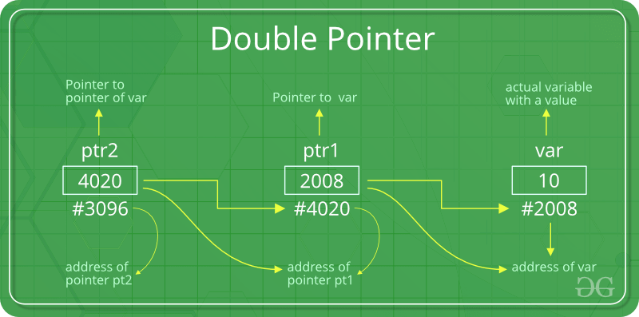

Slide 41
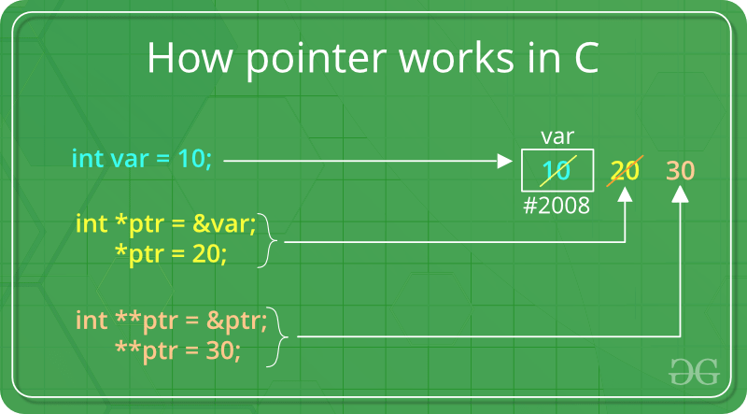

Slide 42
Example
#include<stdio.h>
int main()
{
int var = 789;
int *ptr2;
int **ptr1;
ptr2 = &var;
ptr1 = &ptr2;
printf("Value of var = %d\n", var );
printf("Value of var using single pointer = %d\n", *ptr2 );
printf("Value of var using double pointer = %d\n", **ptr1);
}

Slide 43
Pointer Arithmetic in C
We can perform arithmetic operations on the pointers like addition, subtraction, etc.
However, as we know that pointer contains the address, the result of an arithmetic operation performed on the pointer will also be a pointer if the other operand is of type integer.
In pointer-from-pointer subtraction, the result will be an integer value. Following arithmetic operations are possible on the pointer in C language:
Increment
Decrement
Addition
Subtraction
Comparison

Slide 44
Incrementing Pointer in C
If we increment a pointer by 1, the pointer will start pointing to the immediate next location.
This is somewhat different from the general arithmetic since the value of the pointer will get increased by the size of the data type to which the pointer is pointing.
We can traverse an array by using the increment operation on a pointer which will keep pointing to every element of the array, perform some operation on that, and update itself in a loop.

Slide 45
Decrementing Pointer in C
Like increment, we can decrement a pointer variable.
If we decrement a pointer, it will start pointing to the previous location.
C Pointer Addition
We can add a value to the pointer variable. The formula of adding value to pointer is given below:
p=p+3; //adding 3 to pointer variable
C Pointer Subtraction
Like pointer addition, we can subtract a value from the pointer variable. Subtracting any number from a pointer will give an address.
p=p-3; //subtracting 3 from pointer variable

Slide 46
Illegal arithmetic with pointers
Address + Address = illegal
Address * Address = illegal
Address % Address = illegal
Address / Address = illegal
Address & Address = illegal
Address ^ Address = illegal
Address | Address = illegal
~Address = illegal

